Slide 1
Getting Started with the Microsoft Graph API
Authenticating applications with Microsoft Graph API

Slide 2

Authenticating applications with Microsoft Graph API
Endpoints v1/v2
App registration
Authorization code grant
Implicit grant
Client credentials grant

Slide 3
Azure AD auth endpoints
endpoint
with ADAL
endpoint
with MSAL
v1.0
v2.0
Work and school
Personal
http://aka.ms/aadv2

Slide 4
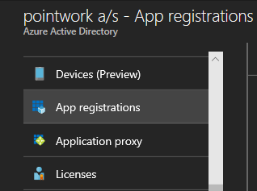
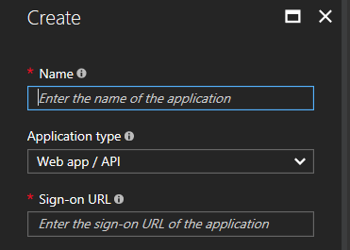
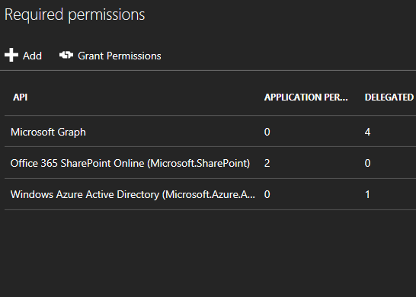
App registration v1.0
Create a new application
https://portal.azure.com
A unique Id is created for your app
Add app platform
Web App, SPA, Daemon
Native App
Web API (Office Add-in)
Add permissions for admin consent flows
For delegated access for all users in the organization
For application access
Notes:
Demo app registration via https://portal.azure.com/#blade/Microsoft_AAD_IAM/ActiveDirectoryMenuBlade/RegisteredApps
Login with bernd@DEV365x973253.onmicrosoft.com

Slide 5
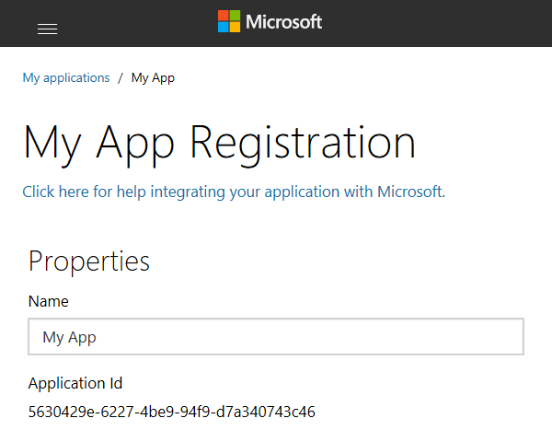
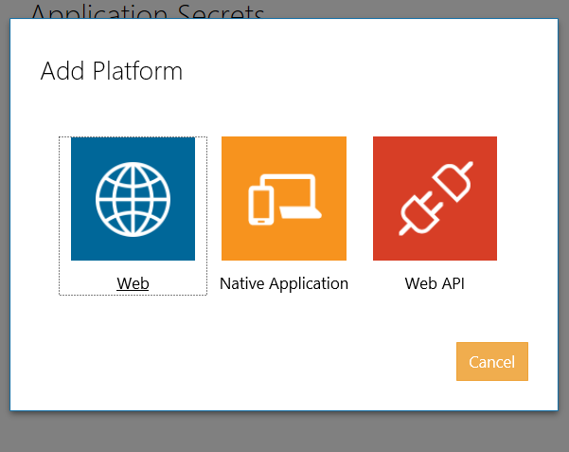
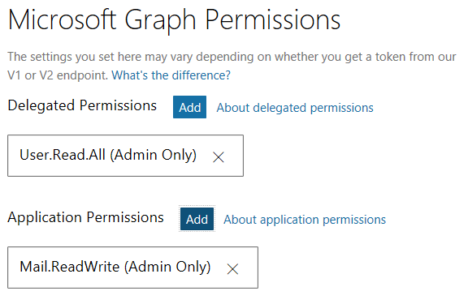
App registration v2.0
Create a new application
https://apps.dev.microsoft.com
A unique Id is created for your app
Add app platform
Web App, SPA, Daemon
Native App
Web API (Office Add-in)
Add permissions for admin consent flows
For delegated access for all users in the organization
For application access
Notes:
TODO: What is Web API app platform?
TODO: A word about consent and admin consent
Demo app registration via https://apps.dev.microsoft.com
Login with bernd@DEV365x973253.onmicrosoft.com

Slide 6
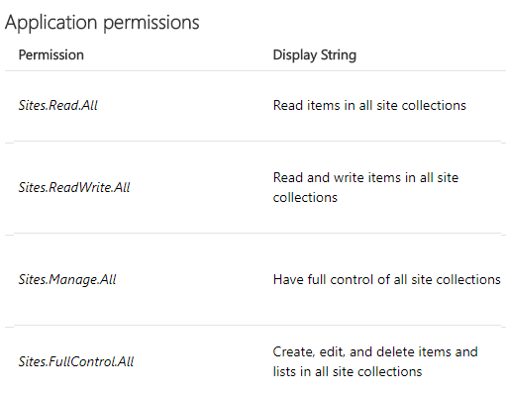
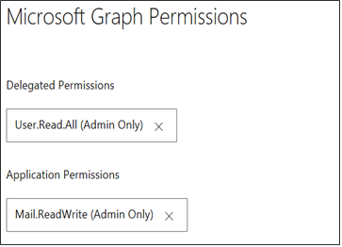
Graph permissions
Delegated permissions – signed-in user
Application permissions – no user signed-in
Effective permissions for delegated permissions (intersection)
Permission names resource.operation.constraint
Sites.FullControl.All, Group.ReadWrite.All, Mail.Send
https://developer.microsoft.com/en-us/graph/docs/concepts/permissions_reference

Slide 7
Authentication
Azure AD
access_token
refresh_token
YOUR APP
MSAL or ADAL
access_token
Microsoft Graph

Slide 8
Authorization code grant – mobile, native and web application
https://login.microsoftonline.com
Application
/common/OAuth/v2.0/authorize
/common/OAuth/v2.0/token
https://graph.microsoft.com
?response_type=code&client_id=…
Sign in, consent
authorization code
?grant_type=authorization_code&code=…
access_token, refresh_token
/v1.0/me (access token)
Current user’s profile
Token expires
?grant_type=refresh_token&refresh_token=…
access_token, refresh_token
/v1.0/me (access token)
Current user’s profile
Notes:
TODO: research token expiration for auth and refresh
The call to /common/OAuth/v2.0/authorize will pop up a login screen and request permissions consent. For web applications this is not a pop-up but a redirect.
Uses back channel only – the browser will never see the auth token. These are only available to the application.
Native applications have no secure storage and do therefore not use a client secret. Web applications must provide a client secret when calling the token endpoint.
It is important to cache the refresh token to request a new access token.
Reference: https://docs.microsoft.com/en-us/azure/active-directory/develop/active-directory-v2-protocols-oauth-code

Slide 9
Using MSAL with mobile and native applications
private static async Task<string> GetTokenForUserAsync()
{
var clientId = "1329f001-78b3-4b0b-ac7b-710bd6f4ec01";
var identityClientApp = new PublicClientApplication(clientId);
string[] scopes = { "User.Read" };
AuthenticationResult authResult;
try
{
// Look in cache for a token for this user with the specified scopes
authResult = await identityClientApp.AcquireTokenSilentAsync(scopes, identityClientApp.Users.First());
return authResult.AccessToken;
}
catch (Exception)
{
// Acquire a refresh and access token
authResult = await identityClientApp.AcquireTokenAsync(scopes);
return authResult.AccessToken;
}
}
Notes:
MSAL makes it easy to create applications that acquire a token and cache locally.
AcquireTokenSilentAsync will look in the cache for an access token that matches the user and scopes you requested. If token isn’t in cache or token is expired, it will attempt to use the refresh token to get a new access token with those scopes.
Notice the scopes are not a fully qualified URI as mentioned previously. Microsoft Graph applications can use a shorthand version.

Slide 10
Demo 04 Authentication code grant
Notes:
Login with bernd@DEV365x973253.onmicrosoft.com
Get oauth token and paste it into https://jwt.io/

Slide 11
Implicit grant – JavaScript application (browser)
https://login.microsoftonline.com/common
Application
/common/OAuth/v2.0/authorize
https://graph.microsoft.com
?response_type=token&client_id=…
Sign in, consent
access_token
/v1.0/me (access token)
Current user’s profile
Token expires
(hidden sign in request)
access_token
/v1.0/me (access token)
Current user’s profile
Notes:
JavaScript applications using the v2 endpoint work similarly to other types of applications, but use a flow type called “implicit flow”.
Uses the front channel only – the browser is fully aware of the access token. Hence there is no need trying to keep it out of the loop by calling two endpoints (authorize and token).
In the implicit flow the access token is passed directly as a hash fragment (not as a URL parameter). This makes it possible to pass an Access Token directly to the client without the risk of it being intercepted by an intermediary server. This has the caveat of only being possible client side and needs javascript running client side to use the access token.
The call to /common/OAuth/v2.0/authorize will pop up a login screen and request permissions consent.
The access token is returned as part of the HTTP response.
The MSAL library handles the hidden sign-in request upon expiration, this is transparent to the user.

Slide 12
Implicit grant
GET https://login.microsoftonline.com/common/oauth2/v2.0/authorize
?response_type=token
&scope=user.read%20mail.send%20openid%20profile
&client_id=cae0f9e6-1e83-4958-864e-53146ae484f4
&redirect_uri=http%3A%2F%2Flocalhost%3A8080%2F
<html><head><title>Object moved</title></head><body>
<h2>Object moved to <a href="http://localhost:8080/#access_token=eyJ0eX... ;
token_type=Bearer
&amp;expires_in=3600
&amp;scope=Files.Read+Mail.Send+User.Read+User.ReadBasic.All
&amp;client_info=eyJ1a...&amp">here</a>.</h2>
</body></html>
Notes:
The implicit flow will cause an HTTP 302 redirect with the access token in the request.

Slide 13
Using MSAL Library with JavaScript applications
clientApplication = createApplication(APPLICATION_CONFIG);
return {
login: function login() {
clientApplication.loginPopup(APPLICATION_CONFIG.graphScopes).then(function (idToken) {
clientApplication.acquireTokenSilent(APPLICATION_CONFIG.graphScopes).then(function (accessToken) {
localStorage.token = accessToken;
window.location.reload();
}, function (error) {
clientApplication.acquireTokenPopup(APPLICATION_CONFIG.graphScopes).then(function (accessToken) {
localStorage.token = accessToken;
}, function (error) {
window.alert("Error acquiring the popup:\n" + error);
});
})
}, function (error) {
window.alert("Error during login:\n" + error);
});
},
Notes:
The code for a JavaScript application is very similar to code used for mobile and native applications. We first attempt to acquire the token silently, and if that fails we prompt the user.

Slide 14
Client credentials grant - daemon applications
https://login.microsoftonline.com
Application
/{tenantId}/OAuth/v2.0/token
/common/adminconsent
https://graph.microsoft.com
?client_id=…&redirect_uri=…
Tenant ID
?client_id=…&client_secret=…
access_token
/v1.0/user (access token)
All users in directory
Notes:
Daemon, server to server, or “headless” applications
Examples are applications that run on a scheduled basis and do not have an interactive user. An admin still needs to grant consent to the app.
Example of requesting admin consent:
https://login.microsoftonline.com/common/adminconsent?client_id=6731de76-14a6-49ae-97bc-6eba6914391e&state=12345&redirect_uri=http://localhost/myapp/permissions
Once an admin has granted consent, there is no more user interaction required. The application provides its client credentials to obtain a fresh token.
Authentication can be based on client secret or certificate (in v1 endpoint only with certificate)
These applications should inspect the exp claim in the token to know when the token will expire.
Resource: https://docs.microsoft.com/en-us/azure/active-directory/develop/active-directory-v2-protocols-oauth-client-creds

Slide 15
Client credentials grant
POST https://login.microsoftonline.com/common/oauth2/v2.0/token
client_id=91430f7a-0e23-4e0a-8984-d2e388caba28
&scope=offline_access+openid+profile+User.Read+User.ReadBasic.All
&grant_type=authorization_code
&code=OAQABA…w3f2xa_SgIAA
&redirect_uri=urn%3Aietf%3Awg%3Aoauth%3A2.0%3Aoob
HTTP/1.1 200 OK
{"token_type":"Bearer",
"scope":"Mail.Send User.Read User.ReadBasic.All",
"expires_in":3599,
"ext_expires_in":262800,
"access_token":"6IkFRQUJBQUF…UFBQUFAB"}

Slide 16
Using MSAL Library with server to server
private static async Task<string> GetTokenForClientAsync()
{
var clientId = "1329f001-78b3-4b0b-ac7b-710bd6f4ec01";
var replyUri = "msal1329f001-78b3-4b0b-ac7b-710bd6f4ec01://auth";
var clientSecret = "";
var tenantId = "DEV365x973253.onmicrosoft.com";
var authority = $"https://login.microsoftonline.com/{tenantId}/v2.0";
var daemonClient = new ConfidentialClientApplication(
clientId,
authority,
replyUri,
new ClientCredential(clientSecret),
null, null);
string[] scopes = { "https://graph.microsoft.com/.default" };
var result = await daemonClient.AcquireTokenForClientAsync(scopes);
return result.AccessToken;
}
Notes:
In previous instances, we used PublicClientApplication, which includes an interactive user. A ConfidentialClientApplication can run without an interactive user, obtaining tokens by providing a secret.
These types of applications require admin consent. Example of admin consent:
https://login.microsoftonline.com/common/adminconsent?client_id=6731de76-14a6-49ae-97bc-6eba6914391e&state=12345&redirect_uri=http://localhost/myapp/permissions

Slide 17
Demo 05 Client credentials grant
Notes:
Add client secret and run.

Slide 18
OpenID Connect and the v2.0 endpoint
https://login.microsoftonline.com/common
Browser
Application
/common/OAuth/v2.0/authorize
/common/OAuth/v2.0/token
https://graph.microsoft.com
?response_type=code&client_id=…
Sign in, consent
id_token, authorization_code
Redirects to RedirectURI
id_token, authorization_code
Validates id_token, sets session cookie
?grant_type=authorization_code&code=
id_token, access_token, refresh_token
/v1.0/me (id token)
Validates id_token
Current user’s profile
Notes:
The call to /common/OAuth/v2.0/authorize will pop up a login screen and request permissions consent. This is how you sign the user into your application. The application receives an id_token, which it needs to validate.
The call to /common/Oauth/v2.0/token retrieves a token to call the Microsoft Graph. Do not need to validate the id_token obtained for the Graph endpoint, the Graph endpoint performs its own id_token validation.

Slide 19
OpenID Connect
GET https://login.microsoftonline.com/common/oauth2/v2.0/authorize
?client_id=cae0f9e6-1e83-4958-864e-53146ae484f4
&redirect_uri=https%3a%2f%2flocalhost%3a44316%2f
&response_mode=form_post
&response_type=id_token
&scope=openid+profile
<html><head><title>Working...</title></head>
<body>
<form method="POST" name="hiddenform"
action="https://localhost:44316/">
<input type="hidden" name="id_token"
value="eyJ0eXAiOh…JrhVUBqI-7prByC5-NAvmjI5Q" />
</form>
<script language="javascript">document.forms[0].submit();</script>
</body></html>
Notes:
OpenID Connect with an ASP.NET web application. The request to the authorize endpoint includes the client ID. Response includes the id_token and will cause an HTTP POST back to your reply URL. The reply URL must match the reply URL that is configured for the application (you cannot coerce it to reply to a URL that isn’t configured for the application).

Slide 20
OWIN OpenID Connect middleware and v2 endpoint
public void ConfigureAuth(IAppBuilder app)
{
app.SetDefaultSignInAsAuthenticationType(CookieAuthenticationDefaults.AuthenticationType);
app.UseCookieAuthentication(new CookieAuthenticationOptions());
app.UseOpenIdConnectAuthentication(
new OpenIdConnectAuthenticationOptions
{
ClientId = appId,
Authority = "https://login.microsoftonline.com/common/v2.0",
PostLogoutRedirectUri = redirectUri,
RedirectUri = redirectUri,
Scope = "openid email profile offline_access " + graphScopes,
TokenValidationParameters = new TokenValidationParameters
{
ValidateIssuer = false,
},
Notes:
Key point is that this uses the ASP.NET middleware with the v2 endpoint. MSAL is not required to sign the user into the application, we can configure the v2.0 endpoint to use with OWIN middleware.
We only need to validate the id_token used to sign the user into the application. We do not validate a token that is used to call a downstream API such as Microsoft Graph.
// In a real application you would use IssuerValidator for additional checks,
// like making sure the user's organization has signed up for your app.
// IssuerValidator = (issuer, token, tvp) =>
// {
// if (MyCustomTenantValidation(issuer))
// return issuer;
// else
// throw new SecurityTokenInvalidIssuerException("Invalid issuer");
// },

Slide 21
Using MSAL with ASP.NET MVC applications
Notifications = new OpenIdConnectAuthenticationNotifications
{
AuthorizationCodeReceived = async (context) =>
{
var code = context.Code;
string signedInUserID = context.AuthenticationTicket.Identity.FindFirst(ClaimTypes.NameIdentifier).Value;
TokenCache userTokenCache = new SessionTokenCache(signedInUserID,
context.OwinContext.Environment["System.Web.HttpContextBase"] as HttpContextBase).GetMsalCacheInstance();
ConfidentialClientApplication cca = new ConfidentialClientApplication(
appId,
redirectUri,
new ClientCredential(appSecret),
userTokenCache,
null);
string[] scopes = graphScopes.Split(new char[] { ' ' });
AuthenticationResult result = await cca.AcquireTokenByAuthorizationCodeAsync(code, scopes);
}
Notes:
Once the user is signed in via the OWIN middleware, the application then uses MSAL to call a downstream API such as Microsoft Graph API.
The OpenID Connect middleware receives a code as part of the Oauth flow. MSAL redeems this code using the AcquireTokenByAuthorizationCodeAsync method, obtaining a token using the scopes provided.

Slide 22
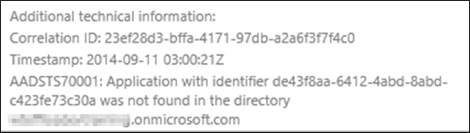
Troubleshooting errors in Auth flow
Login errors
Shown on web page
Fiddler
Shows response/request from apps running on local computer
Review response as JSON
Authentication errors (invalid values)
{"error":"invalid_grant","error_description":"AADSTS70002: Error validating credentials. AADSTS50011: The reply address 'http://localhost:40298/Home/Discovery' is not valid.}

Slide 23
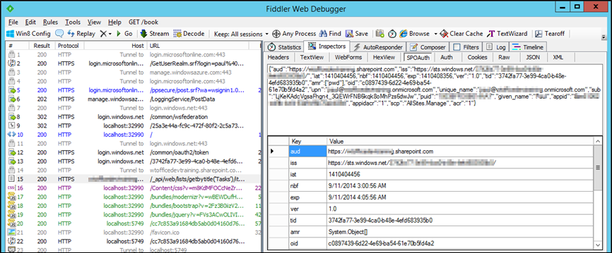
Troubleshooting tokens
Fiddler
Extension to view SharePoint 2013 App tokens
http://blogs.msdn.com/b/kaevans/archive/2013/08/25/creating-a-fiddler-extension-for-sharepoint-2013-app-tokens.aspx
Online Paste token in web page
http://jwt.io/

Slide 24

New Azure function bindings
PREVIEW
Bindings for Microsoft Graph
Uses Microsoft Graph .Net SDK
Auth is handled for you!!!
Microsoft Graph
Web hook
triggers function
Azure Function queries
Microsoft Graph

Slide 25
Demo Avoid the auth hassle - use Azure functions

Slide 26

Summary
New endpoint for Azure AD provides converged authentication for personal accounts as well as work or school accounts.
New MSAL libraries simplify applications that have multiple platform components.
Using MSAL with delegated and app-only permissions is quite different.
Azure AD v2 endpoint supports only Microsoft Graph API.

Slide 27
Thank you

